Slide 1


How Well Are Sri Lankan Websites Archived?
Presented By:
Sivakanesan Dhanushkanda
PhD Student
Department of Computer Science
Old Dominion University, Norfolk, Virginia
@siva_skanda
Created as a course requirement for CS895 Web Archiving Forensics (by Dr.Michael L. Nelson), Fall 2022

Slide 2
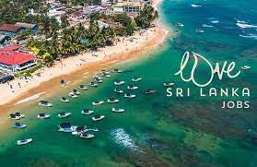
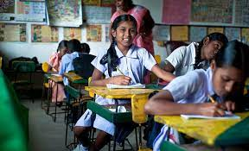
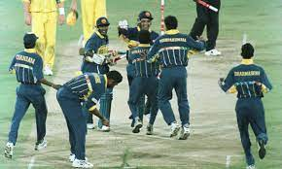
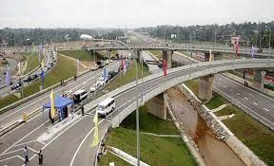
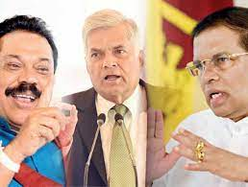
The History of Sri Lanka Needs to Be Preserved
https://www.lovesrilanka.org/wp-content/uploads/2022/01/Jobs-Portal-Thumbnail-SL.jpg
https://www.yourcommonwealth.org/wp-content/uploads/2014/08/medium_69880434471-640x390.jpg
https://moderndiplomacy.eu/wp-content/uploads/2018/11/sri-lanka-crisis.jpg
Logistic-and-transportation-infrastructure-in-sri-lanka.html
https://ichef.bbci.co.uk/onesport/cps/624/cpsprodpb/DF0E/production/_117720175_srilanka1996.jpg
‹#›

Slide 3



A Few Studies in the Past
Web archiving for Sri Lanka
Umanda Dikwatta; Gihan Dias [1]
Complications when archiving Sri Lankan sites
A system to regularly archive Sri Lankan websites with duplication reduction
Web archive collections
Sri Lankan Elections Web Archive: LOC [2]
South Asian Open Archives [3]
26 current member research libraries
27 Languages
Princeton University library
“Dissidents and Activists in Sri Lanka, 1960s to 1990s,” [4]
[1] https://ieeexplore.ieee.org/document/8285646
[2] https://www.loc.gov/collections/sri-lankan-elections-web-archive/about-this-collection/
[3] https://www.jstor.org/site/saoa/
[4] https://library.princeton.edu/news/general/2021-05-11/now-online-30-plus-years-sri-lankan-activism

Slide 4
Internet World Stats-2022
Region | Population ( 2022 Est.) | Internet Users, (Year 2000) | Internet Users 31-JULY-22 | Penetration % Population | Users % Asia
Japan | 127,202,192 | 47,080,000 | 118,626,672 | 93.3 % | 4.0 %
China | 1,448,314,408 | 22,500,000 | 1,010,740,000 | 69.8 % | 34.4 %
Korea, South | 51,340,112 | 19,040,000 | 49,799,909 | 97.0 % | 1.7 %
Taiwan | 23,886,225 | 6,260,000 | 22,639,500 | 94.8 % | 0.8 %
India | 1,402,228,175 | 5,000,000 | 833,710,000 | 59.5 % | 28.4 %
Sri Lanka | 21,558,620 | 121,500 | 8,879,700 | 41.2 % | 0.3 %
Asia Total | 4,352,169,960 | 114,304,000 | 2,934,186,678 | 67.4 % | 100.0 %
Rest of World | 3,582,292,671 | 45.1 % | 2,538,869,058 | 70.9 % | 46.4 %
All the World | 7,934,462,631 | 100.0 % | 5,473,055,736 | 69.0 % | 100.0 %
https://www.internetworldstats.com/stats3.htm#asia

Slide 5
Internet World Stats-2022
Region | Population ( 2022 Est.) | Internet Users, (Year 2000) | Internet Users 31-JULY-22 | Penetration % Population | Users % Asia
Japan | 127,202,192 | 47,080,000 | 118,626,672 | 93.3 % | 4.0 %
China | 1,448,314,408 | 22,500,000 | 1,010,740,000 | 69.8 % | 34.4 %
Korea, South | 51,340,112 | 19,040,000 | 49,799,909 | 97.0 % | 1.7 %
Taiwan | 23,886,225 | 6,260,000 | 22,639,500 | 94.8 % | 0.8 %
India | 1,402,228,175 | 5,000,000 | 833,710,000 | 59.5 % | 28.4 %
Sri Lanka | 21,558,620 | 121,500 | 8,879,700 | 41.2 % | 0.3 %
Asia Total | 4,352,169,960 | 114,304,000 | 2,934,186,678 | 67.4 % | 100.0 %
Rest of World | 3,582,292,671 | 45.1 % | 2,538,869,058 | 70.9 % | 46.4 %
All the World | 7,934,462,631 | 100.0 % | 5,473,055,736 | 69.0 % | 100.0 %
From <1% to >40%
https://www.internetworldstats.com/stats3.htm#asia

Slide 6
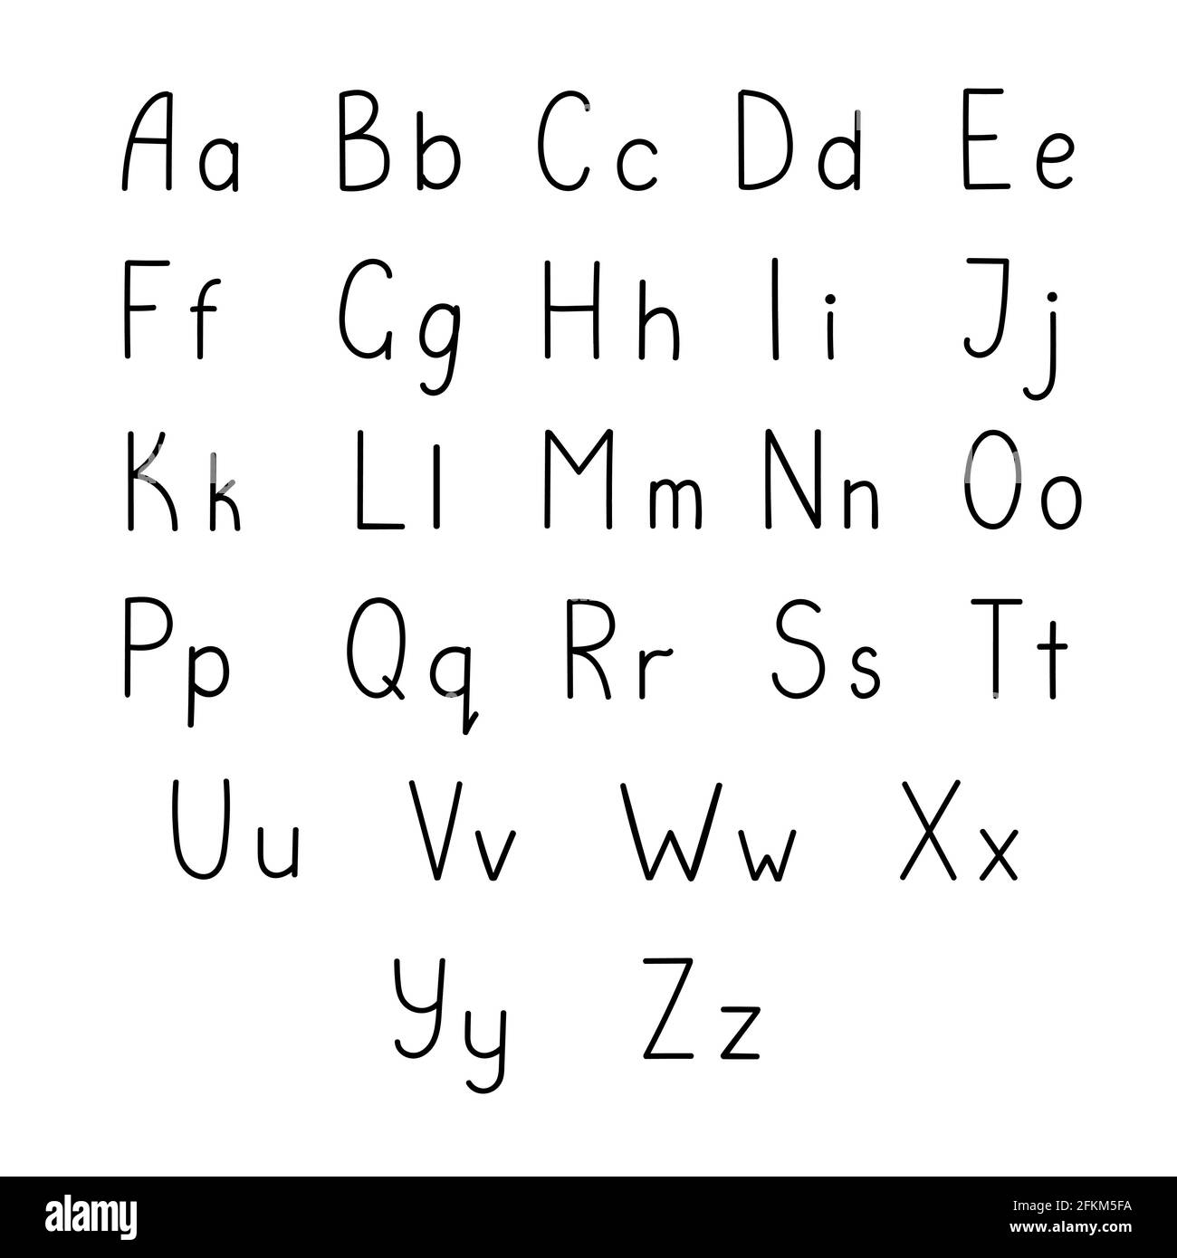
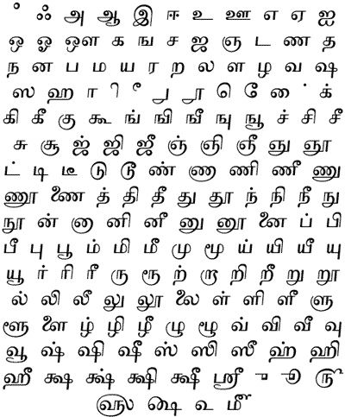
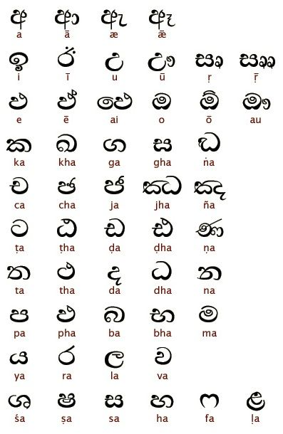
Sri Lanka Has Three Languages
https://www.alamy.com/small-hand-drawn-black-letters-of-english-alphabet-in-doodle-style-outline-vector-illustration-calligraphic-abc-cute-funny-decorative-handwriting-contour-lined-art-lettering-image425170686.html
https://www.pinterest.com/pin/434667801506088520/
https://in.pinterest.com/pin/623185667168549504/

Slide 7
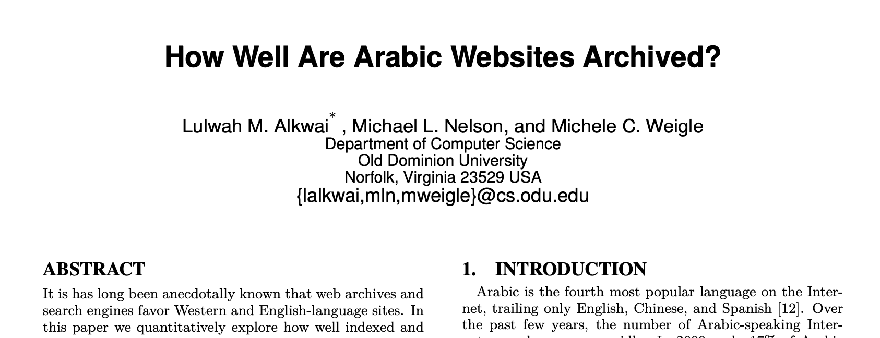
My Investigation Was Inspired by
Dr. Alkwai’s Previous Study
Arabic websites Vs. Sri Lankan websites (English, Sinhala, and Tamil)
https://www.cs.odu.edu/~mln/pubs/jcdl-2015/jcdl-2015-arabic-sites.pdf

Slide 8
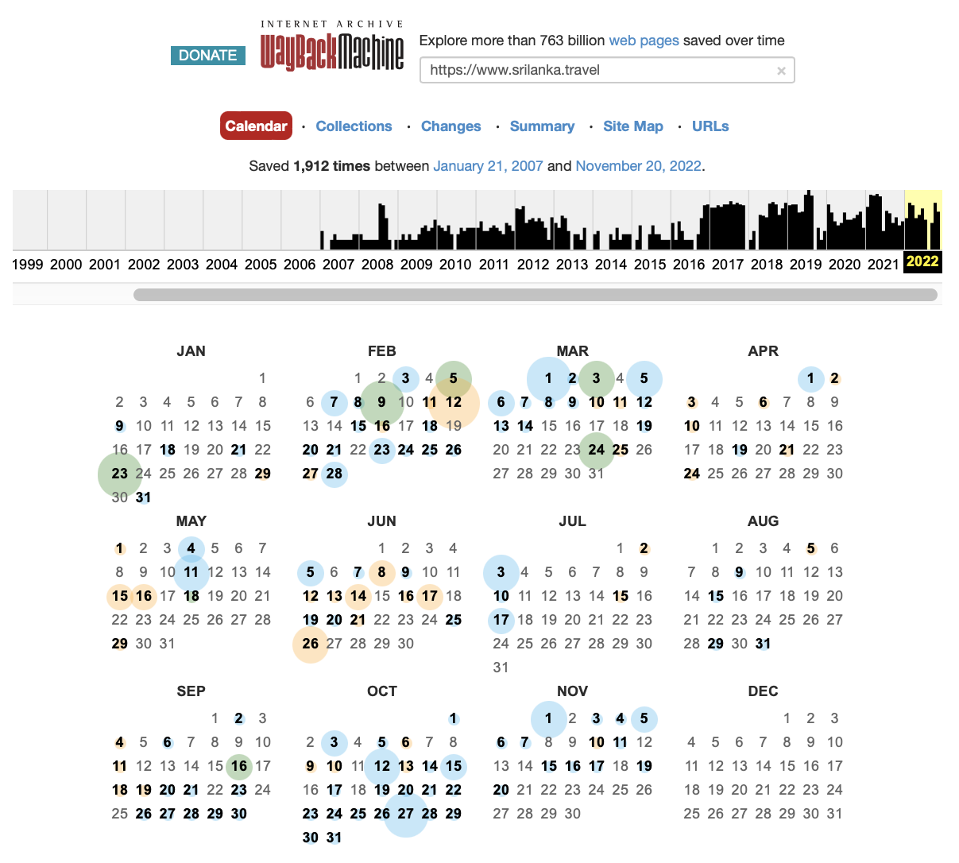
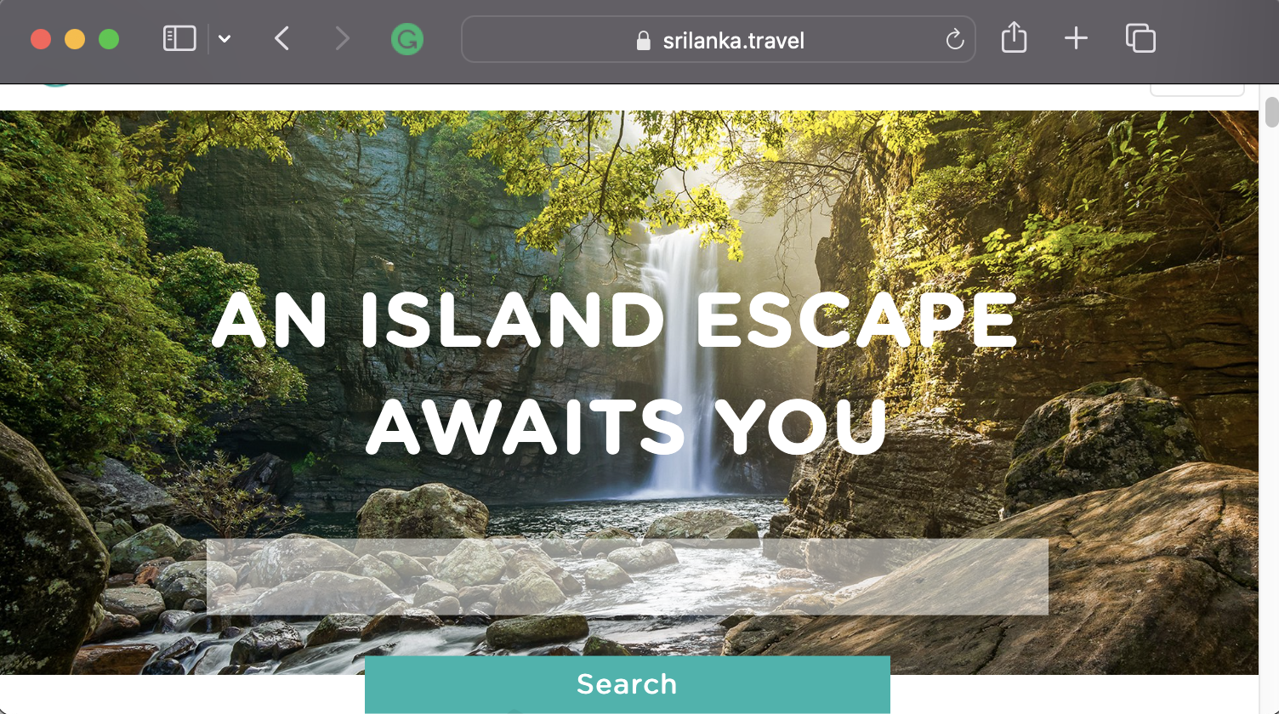
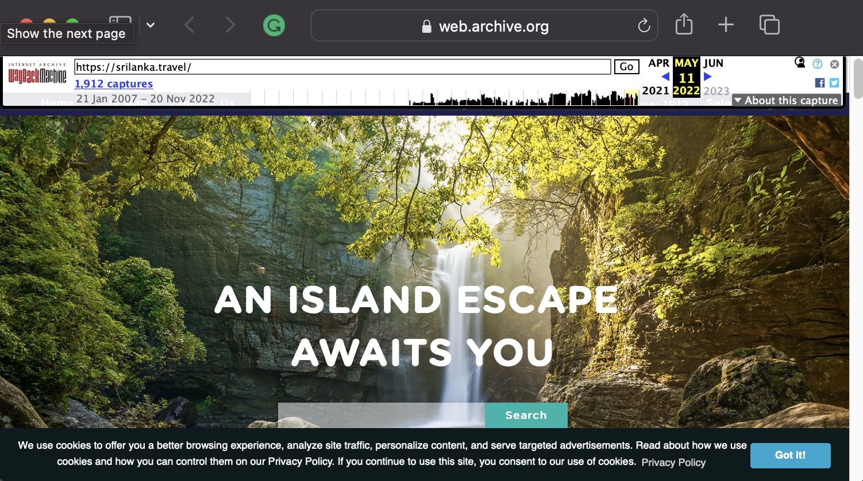
Memento protocol
URI-R: Original resource as it used to appear on the live Web.
A URI-R may have 0 or more mementos (URI-Ms).
URI-M: an archived snapshot of the URI-R at a specific date and time, which is called the Memento-Date- time
URI-T: TimeMap - a resource that provides a list of mementos (URI-Ms) for a URI-R, ordered by their Memento-Datetimes.

Slide 9
Study’s Various Phases
Filter Unique URI-Rs
Testing on Live web
Downloading HTML content
Detecting Seed URI-Rs
Results & Analysis
Determine Language
HTTP Content-Language
Language Detection API

Slide 10
Selecting Seed URIs
Datasets
Alexa top 1 million
“.lk”: 435 URI-Rs
“lanka”: 68 URI-Rs
Total: 503 URI-Rs
One World Nations Online directory: https://www.nationsonline.org/oneworld/sri_lanka.htm
Alexa ranking: 37487
Scraped the webpage
Obtained 74 web URI-Rs from 7 different categories (Business, Culture, Education, Environment, Government, History, News)
Combined: 576 URI-Rs → Unique: 535

Slide 11
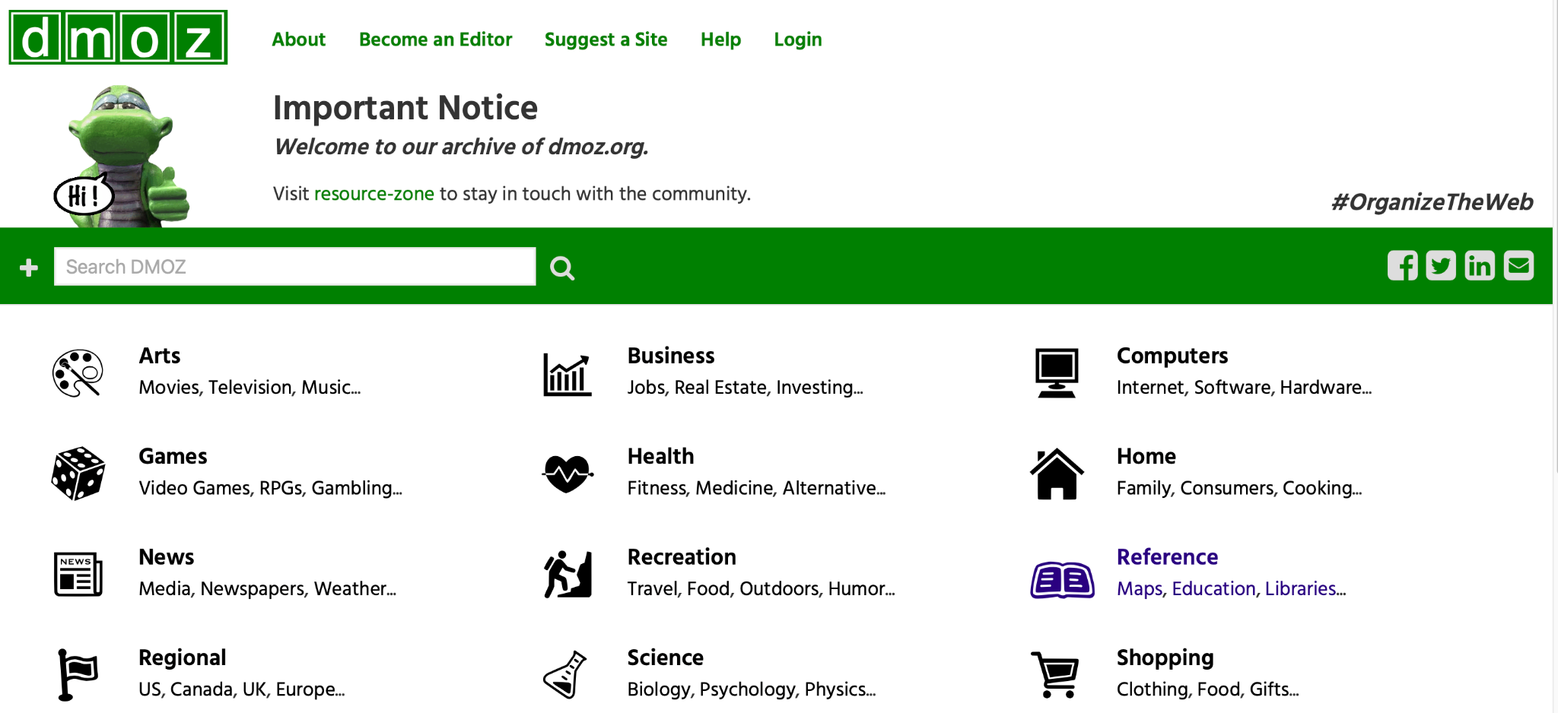
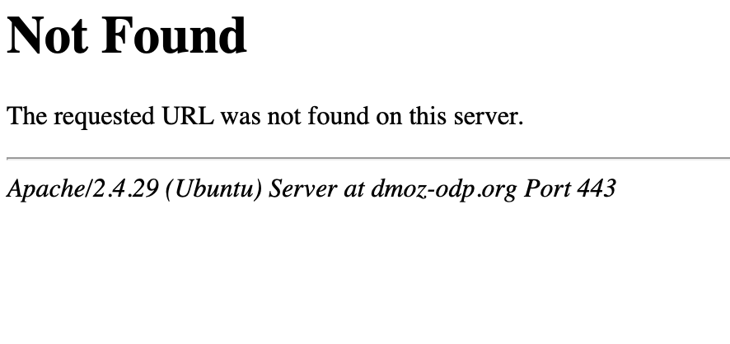
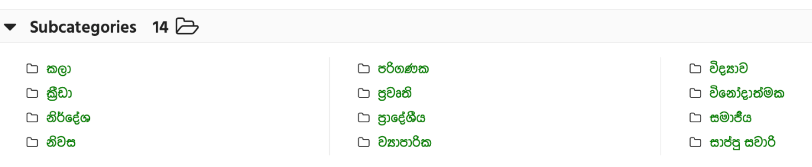
DMOZ Directory Had Broken Links for “Sinhala”
https://dmoz-odp.org/World/Sinhala/%E0%B6%9A%E0%B7%8A%E2%80%8D%E0%B6%BB%E0%B7%93%E0%B6%A9%E0%B7%8F/
https://dmoz-odp.org/
https://dmoz-odp.org/World/Sinhala/
‹#›

Slide 12
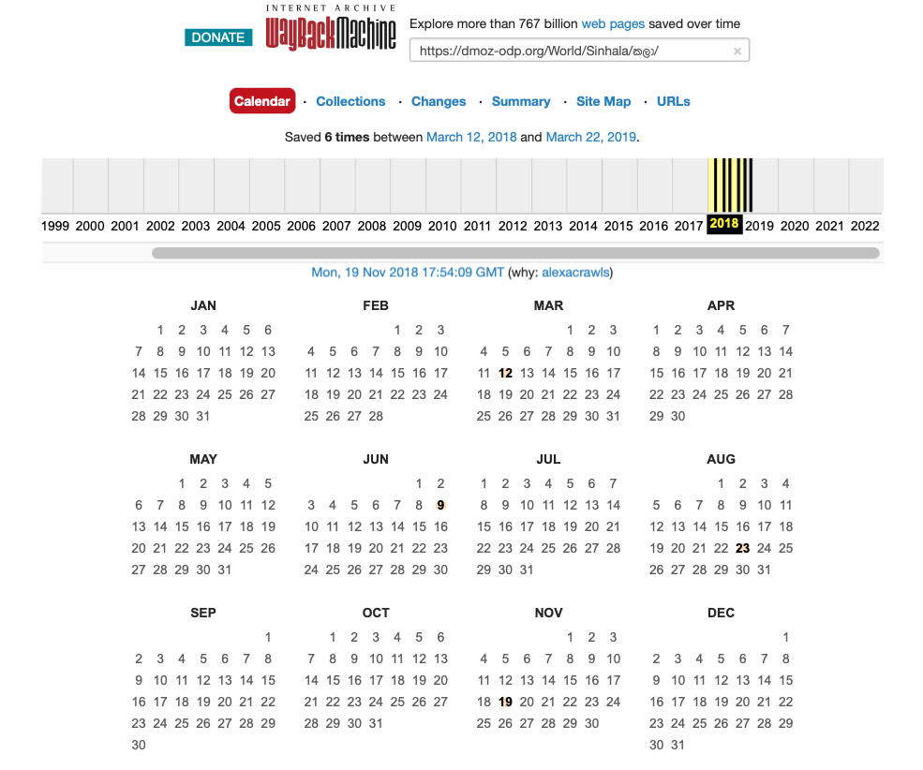
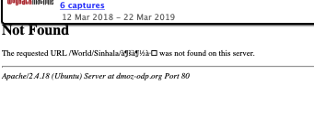
The Mementos for DMOZ Directory (“Sinhala”) Has Also Captured the “Not Found” Page
https://dmoz-odp.org/
https://web.archive.org/web/20181119175409/https://dmoz-odp.org/World/Sinhala/%E0%B6%9A%E0%B6%BD%E0%B7%8F/
https://web.archive.org/web/20180615000000*/https://dmoz-odp.org/World/Sinhala/%E0%B6%9A%E0%B6%BD%E0%B7%8F/

Slide 13
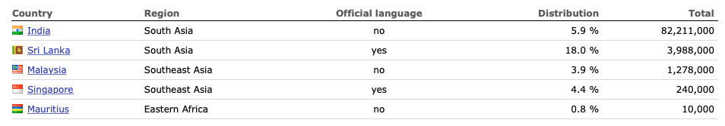
Tamil Is Not Just Spoken in Sri Lanka
https://www.worlddata.info/languages/tamil.php

Slide 14
Testing the Existence of Each Seed URI-R on the Live Web
Checked status code for 535 unique URI-R
Downloaded HTML content
Set timeout for 10 seconds and printed error codes
478 files collected and 57 errors
User-agent
Googlebot
Mozilla/5.0 (Windows NT 10.0; Win64; x64) AppleWebKit/537.36 (KHTML, like Gecko) Chrome/58.0.3029.110 Safari/537.36
Status code
Status code | No. of URI-Rs | Percentage
200 | 464 | 86.7%
4xx | 12 | 2.2%
5xx | 2 | 0.4%
non-HTTP errors | 57 | 10.6%
‹#›

Slide 15
Detecting the Language
HTTP content-language header
ISO 629-2 code for
Sinhala: “si”
Tamil: “ta”
Present: 22
“si”: 2
en-US: 1
en: 19
Absent: 445 (no content headers)
Error: 68
2. Language Detection API client
https://detectlanguage.com
Detects 164 languages
Only 4.7% have the content-language headers
Language | Number of URI-Rs
English | 381
Sinhala | 56
Tamil | 9
Others | 9
Not detected | 80
https://ws-dl.blogspot.com/2016/03/2016-03-22-language-detection-where-to.html
‹#›

Slide 16
Language detection process
Remove HTML tags using BeautifulSoup
Obtain text data without tags
HTML content
[{'isReliable': True, 'confidence': 12.04, 'language': 'ta'}]
Import detectlanguage & detect languages
Returns True or False
Confidence rate is not a range, can be higher than 100
Language
5000 requests/day (1MB/day)- Free

Slide 17
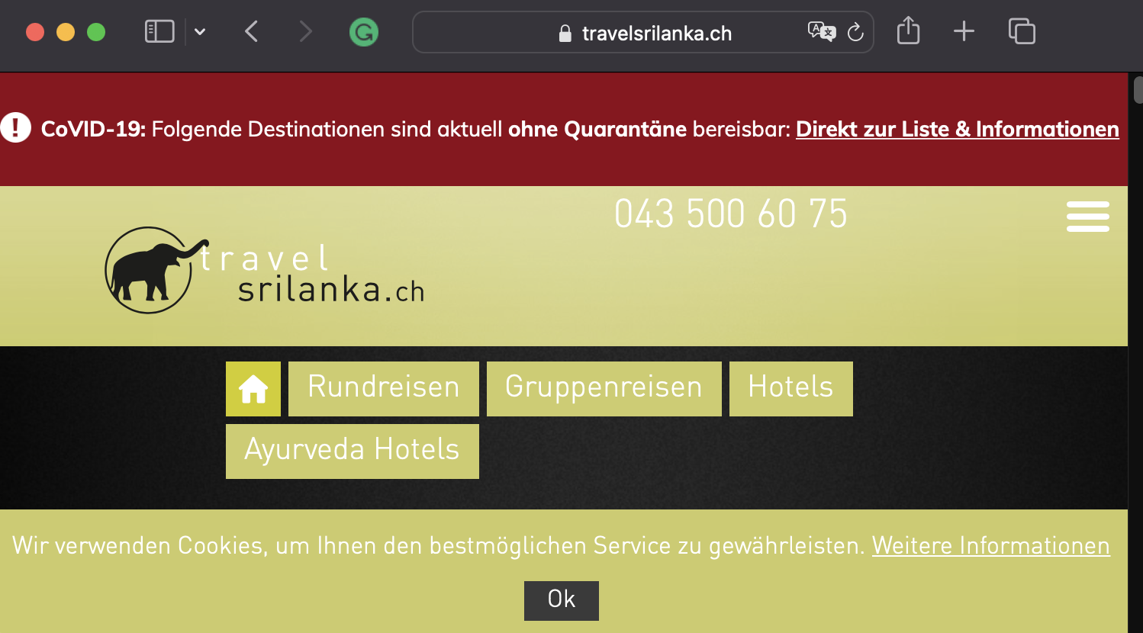
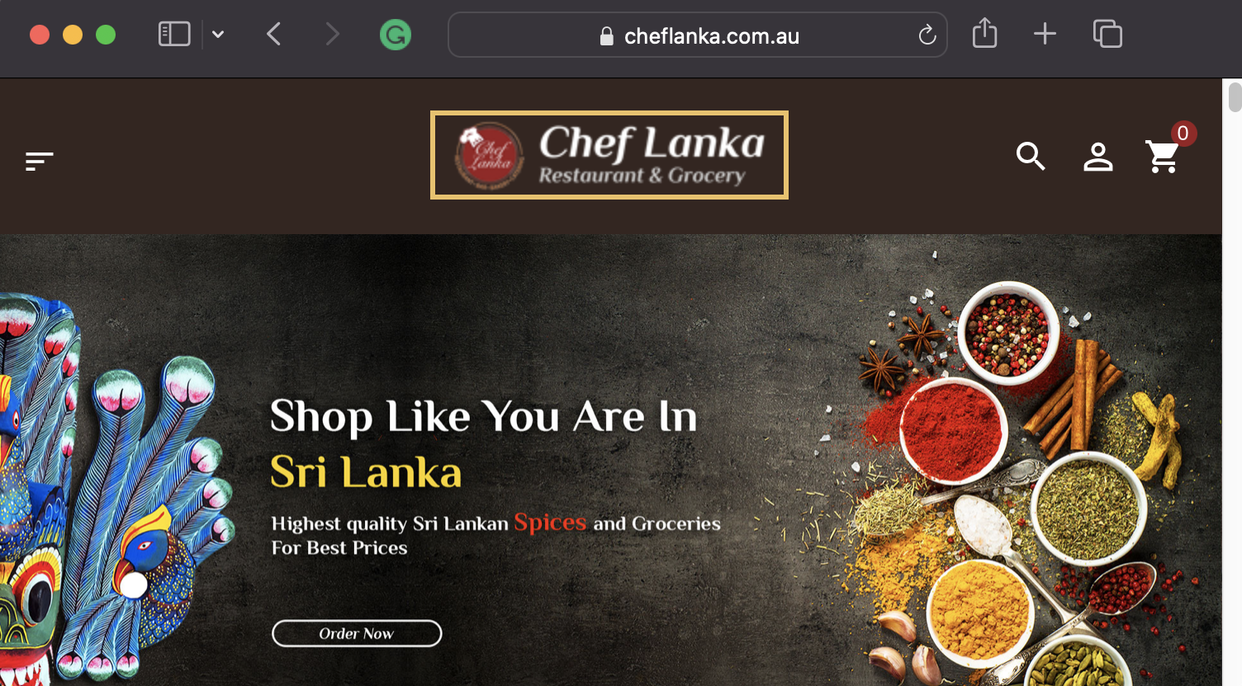
Topmost Top-Level-Domains
TLD | No. of URI-Rs
lk | 451
com | 61
org | 9
net | 8
info | 3
ch | 1
au | 1
https://www.travelsrilanka.ch/
https://cheflanka.com.au/
‹#›

Slide 18
84% (450 Out of 535) URI-Rs Have at Least One Copy in the Internet Archive
Top 25 most archived sites
# | URI-R | No. of URI-Ms | Category
1 | google.lk | 34719 | Search engine
2 | island.lk | 25859 | News
3 | dailymirror.lk | 23296 | News
4 | tamilnet.com | 23065 | News
5 | lankadeepa.lk | 23061 | News
6 | newsfirst.lk | 22698 | News
7 | lankatruth.com | 22361 | News
8 | news.lk | 19086 | News
9 | ft.lk | 18306 | News
10 | dailynews.lk | 17664 | News
11 | tamilmirror.lk | 17133 | News
12 | colombopage.com | 16832 | News
13 | nation.lk | 16633 | News
14 | silumina.lk | 16447 | News
15 | adaderana.lk | 15483 | News
16 | lankatimes.com | 15213 | News
17 | slbc.lk | 14185 | News
18 | documents.gov.lk | 13678 | Government
19 | mawbima.lk | 12320 | News
20 | ceylontoday.lk | 11331 | News
21 | gov.lk | 11117 | Government
22 | goldfm.lk | 10604 | News
23 | dinamina.lk | 9761 | News
24 | hirunews.lk | 4021 | News
25 | http://slpost.gov.lk/ | 3512 | Government

Slide 19
84% (450 Out of 535) URI-Rs Have at Least One Copy in the Internet Archive
Top 25 most archived sites
# | URI-R | No. of URI-Ms | Category
1 | google.lk | 34719 | Search engine
2 | island.lk | 25859 | News
3 | dailymirror.lk | 23296 | News
4 | tamilnet.com | 23065 | News
5 | lankadeepa.lk | 23061 | News
6 | newsfirst.lk | 22698 | News
7 | lankatruth.com | 22361 | News
8 | news.lk | 19086 | News
9 | ft.lk | 18306 | News
10 | dailynews.lk | 17664 | News
11 | tamilmirror.lk | 17133 | News
12 | colombopage.com | 16832 | News
13 | nation.lk | 16633 | News
14 | silumina.lk | 16447 | News
15 | adaderana.lk | 15483 | News
16 | lankatimes.com | 15213 | News
17 | slbc.lk | 14185 | News
18 | documents.gov.lk | 13678 | Government
19 | mawbima.lk | 12320 | News
20 | ceylontoday.lk | 11331 | News
21 | gov.lk | 11117 | Government
22 | goldfm.lk | 10604 | News
23 | dinamina.lk | 9761 | News
24 | hirunews.lk | 4021 | News
25 | http://slpost.gov.lk/ | 3512 | Government

Slide 20
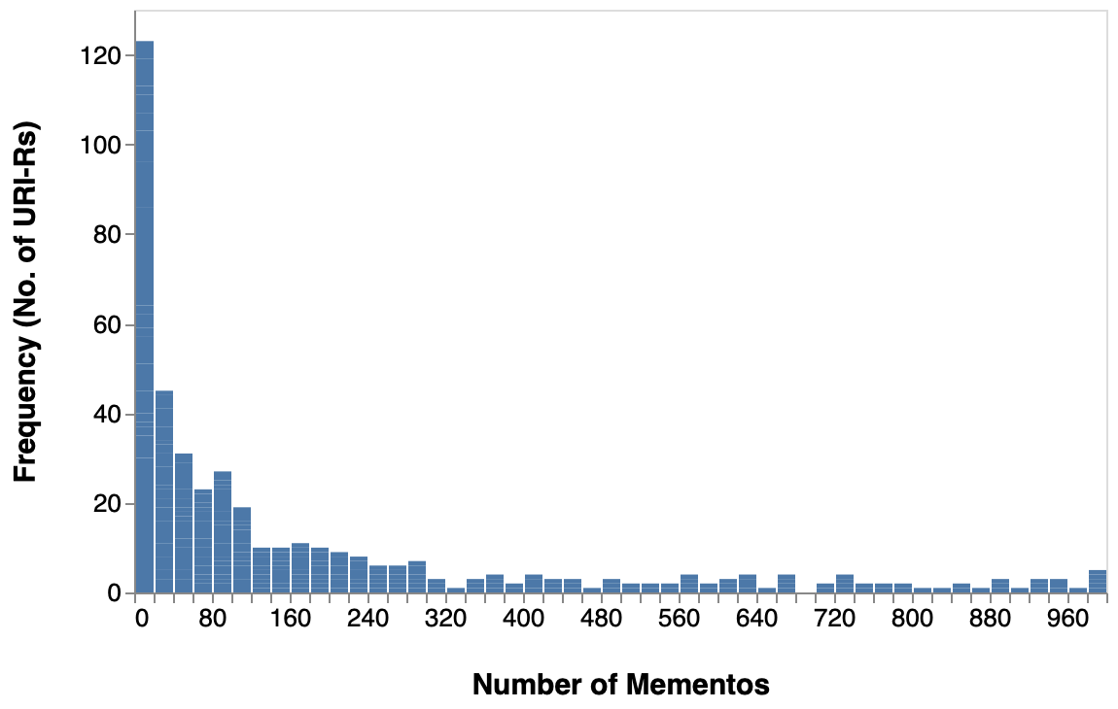
121 Out of 451 URI-Rs Have Less Than 20 URI-Ms

Slide 21
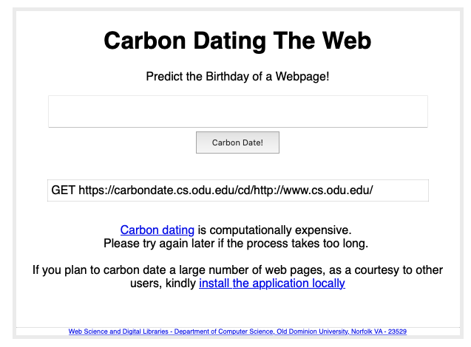
CarbonDate Estimates the Oldest Date Found As
The Creation Date
{
"self": "http://carbondate.cs.odu.edu/cd/http://www.cs.odu.edu/",
"uri": "http://www.cs.odu.edu/",
"estimated-creation-date": "1996-02-09T21:47:46",
"earliest-sources": [
"web.archive.org"
],
"sources": {
"web.archive.org": {
"uri-m": "https://web.archive.org/web/19970102130137/http://cs.odu.edu:80/",
"memento-datetime": "1996-02-09T21:47:46",
"memento-pubdate": "",
"earliest": "1996-02-09T21:47:46" },
…..
},
"backlinks": { "earliest": "" },
"bing.com": { "earliest": "" },
"bitly.com": { "earliest": ""},
"google.com": { "earliest": ""},
"last-modified": { "earliest": "" },
"pubdate": { "earliest": ""},
"twitter.com": { "earliest": ""} }}
https://carbondate.cs.odu.edu/
https://carbondate.cs.odu.edu/#http://www.cs.odu.edu/

Slide 22
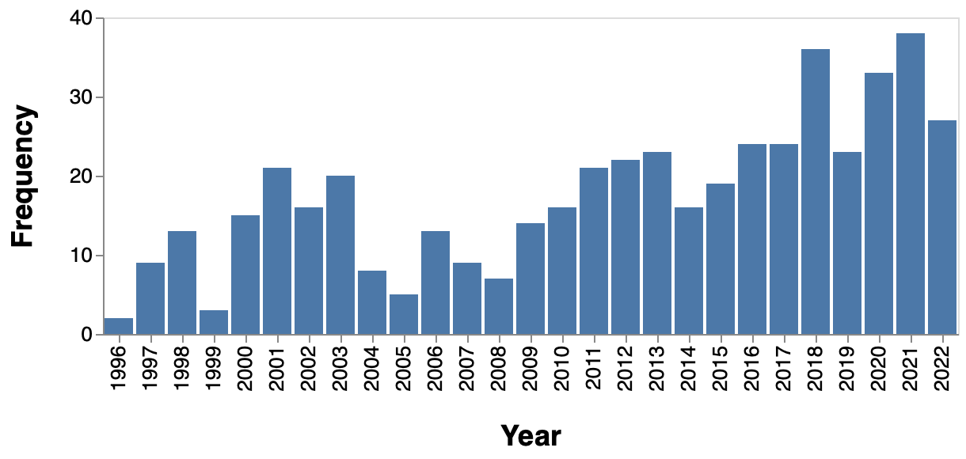
Creation Dates for URI-Rs

Slide 23
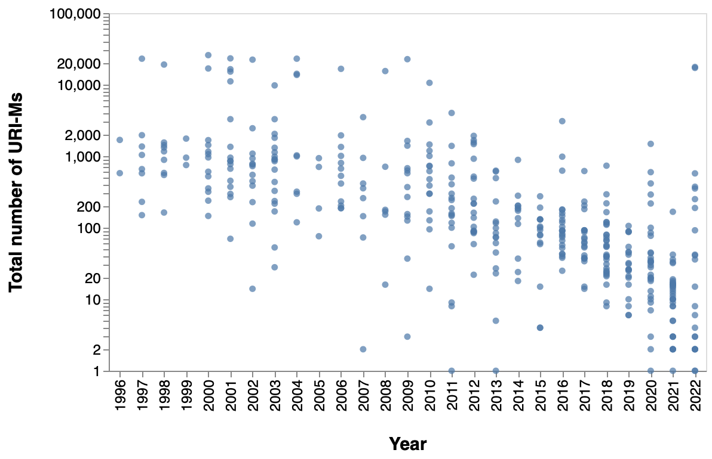
Creation Date vs Number of URI-Ms for Each URI-R
Each dot in the chart represents a unique URI-R

Slide 24
Creation Date vs Number of URI-Ms for Each URI-R
www.dailynews.lk
{
"self": http://carbondate.cs.odu.edu/cd/http://dailynews.lk",
"uri": "http://dailynews.lk",
"estimated-creation-date": "2022-11-28T15:20:43",
"earliest-sources": [ "last-modified" ],
….
"last-modified": { "earliest": "2022-11-28T15:20:43"}
….
}
CarbonDate gives the “last-modified” date as the creation date
‹#›

Slide 25
MemGator
Memento Aggregator
Queries 16 different web archives to look for mementos for a given URI-R
Ran memgator on the 535 sites
450 URI-Rs have at least one memento in any of the archive
190 URI-Rs (42% of 450) have mementos only at the Internet Archive
Sample output
url,archive,copies
3cs.lk,web.archive.org,486
3cs.lk,archive.md,1
3cs.lk,wayback.archive-it.org,92
3cs.lk,arquivo.pt,4
abansit.lk,web.archive.org,92
abansit.lk,arquivo.pt,2
ada.lk,web.archive.org,1557
ada.lk,archive.md,1
https://github.com/oduwsdl/MemGator

Slide 26
MemGator
Memento Aggregator
Queries 16 different web archives to look for mementos for a given URI-R
Ran memgator on the 535 sites
450 URI-Rs have at least one memento in any of the archive
190 URI-Rs (42% of 450) have mementos only at the Internet Archive
Sample output
url,archive,copies
3cs.lk,web.archive.org,486
3cs.lk,archive.md,1
3cs.lk,wayback.archive-it.org,92
3cs.lk,arquivo.pt,4
abansit.lk,web.archive.org,92
abansit.lk,arquivo.pt,2
ada.lk,web.archive.org,1557
ada.lk,archive.md,1
https://github.com/oduwsdl/MemGator
‹#›

Slide 27
MemGator Request & Response
skandasiva@Skandas-MBP-2 ~ % curl -s "https://memgator.cs.odu.edu/timemap/link/asianmirror.lk"
<http://asianmirror.lk>; rel="original",
<https://memgator.cs.odu.edu/timemap/link/http://asianmirror.lk>; rel="self"; type="application/link-format",
<https://web.archive.org/web/20110428233705/http://www.asianmirror.lk:80/>; rel="first memento"; datetime="Thu, 28 Apr 2011 23:37:05 GMT",
...
<https://web.archive.org/web/20110430013320/http://www.asianmirror.lk:80/>; rel="memento"; datetime="Sat, 30 Apr 2011 01:33:20 GMT",
<https://www.webarchive.org.uk/wayback/archive/20141104035517mp_/http://www.asianmirror.lk/>; rel="memento"; datetime="Tue, 04 Nov 2014 03:55:17 GMT",
<https://webarchive.loc.gov/all/20150106202238/http://www.asianmirror.lk/>; rel="memento"; datetime="Tue, 06 Jan 2015 20:22:38 GMT",
<https://wayback.archive-it.org/all/20150107083015/http://www.asianmirror.lk/>; rel="memento"; datetime="Wed, 07 Jan 2015 08:30:15 GMT",
...
<https://web.archive.org/web/20221110102528/https://www.asianmirror.lk/>; rel="last memento"; datetime="Thu, 10 Nov 2022 10:25:28 GMT",
<https://memgator.cs.odu.edu/timemap/link/http://asianmirror.lk>; rel="timemap"; type="application/link-format",
<https://memgator.cs.odu.edu/timemap/json/http://asianmirror.lk>; rel="timemap"; type="application/json",
<https://memgator.cs.odu.edu/timemap/cdxj/http://asianmirror.lk>; rel="timemap"; type="application/cdxj+ors",
<https://memgator.cs.odu.edu/timegate/http://asianmirror.lk>; rel="timegate"

Slide 28
If Any Other Archive Has It,
Internet Archive Most Definitely Does!
Web Archive | Domain | No. of URI-Rs > one URI-M | Percentage
Internet Archive | web.archive.org | 450 | 100.0%
Portuguese Web Archive | arquivo.pt | 219 | 48.6%
archive.today | archive.md | 174 | 38.6%
Archive-It | wayback.archive-it.org | 116 | 25.7%
Library of Congress | webarchive.loc.gov | 85 | 18.8%
Australian Web Archive | web.archive.org.au | 46 | 10.2%
Stanford Web Archive | swap.stanford.edu | 21 | 4.6%
Icelandic Web Archive | wayback.vefsafn.is | 16 | 3.5%
Perma.cc | perma.cc | 13 | 2.8%
UK Web Archive | www.webarchive.org.uk | 6 | 1.3%

Slide 29
Top 5 URI-Rs in Every Web Archive
Archive / Rank | 1 | 2 | 3 | 4 | 5
archive.md | nethnews.lk | lankacnews.com | mawbima.lk | ikman.lk | nic.lk
arquivo.pt | google.lk | thinakkural.lk | dailymirror.lk | dailynews.lk | lankadeepa.lk
perma.cc | tamilnet.com | nipo.gov.lk | news.lk | nation.lk | mfa.gov.lk
swap.stanford.edu | island.lk | defence.lk | google.lk | dailymirror.lk | president.gov.lk
wayback.archive-it.org | google.lk | tamilnet.com | hirunews.lk | slembassyusa.org | gov.lk
wayback.vefsafn.is | gov.lk | google.lk | tamilnet.com | police.lk | srilankan.com
web.archive.org | google.lk | island.lk | dailymirror.lk | tamilnet.com | lankadeepa.lk
web.archive.org.au | cheflanka.com.au | customs.gov.lk | dailynews.lk | dailymirror.lk | island.lk
webarchive.loc.gov | news.lk | atimes.com | island.lk | dailynews.lk | slembassyusa.org
webarchive.org.uk | britishcouncil.lk | dilmahtea.com | radio.com.lk | asianmirror.lk | newsfirst.lk
‹#›

Slide 30
CDX Prefix Search
skandasiva@Skandas-MBP-2 ~ % curl -s "http://web.archive.org/cdx/search/cdx?url=asianmirror.lk&matchType=prefix"
lk,asianmirror)/ 20110428233705 http://www.asianmirror.lk:80/ text/html 403 4O5DUGPKXRXRJWMOAP2JNMKPGGSMLDNX 2199
lk,asianmirror)/ 20110430013320 http://www.asianmirror.lk:80/ text/html 200 M5Q2U6B4YIFVBIASBVZUKZ5MCNGVM2WY 42535
lk,asianmirror)/ 20110829005653 http://www.asianmirror.lk:80/ text/html 200 FG7AUWNO33FYFSYCTMR6W7TG3V7KKMUT 19408
lk,asianmirror)/ 20110830094403 http://www.asianmirror.lk:80/ text/html 200 LAZGT7W3DN4CA3GN6ME4CIW3TRVJDFZK 19006
lk,asianmirror)/ 20110923063550 http://www.asianmirror.lk:80/ text/html 200 WFJFLPBPPTLDOESL6IO3WUZCYAKLOVT5 20052
…
Raw CDX format

Slide 31
CDX Prefix Search
skandasiva@Skandas-MBP-2 ~ % curl -s "http://web.archive.org/cdx/search/cdx?url=asianmirror.lk&matchType=prefix"
lk,asianmirror)/ 20110428233705 http://www.asianmirror.lk:80/ text/html 403 4O5DUGPKXRXRJWMOAP2JNMKPGGSMLDNX 2199
lk,asianmirror)/ 20110430013320 http://www.asianmirror.lk:80/ text/html 200 M5Q2U6B4YIFVBIASBVZUKZ5MCNGVM2WY 42535
lk,asianmirror)/ 20110829005653 http://www.asianmirror.lk:80/ text/html 200 FG7AUWNO33FYFSYCTMR6W7TG3V7KKMUT 19408
lk,asianmirror)/ 20110830094403 http://www.asianmirror.lk:80/ text/html 200 LAZGT7W3DN4CA3GN6ME4CIW3TRVJDFZK 19006
lk,asianmirror)/ 20110923063550 http://www.asianmirror.lk:80/ text/html 200 WFJFLPBPPTLDOESL6IO3WUZCYAKLOVT5 20052
…
Raw CDX format
skandasiva@Skandas-MBP-2 ~ % curl -s "http://web.archive.org/cdx/search/cdx?url=asianmirror.lk&matchType=prefix" | awk '{print "https://web.archive.org/web/" $2 "/" $3};'
https://web.archive.org/web/20110428233705/http://www.asianmirror.lk:80/
https://web.archive.org/web/20110430013320/http://www.asianmirror.lk:80/
https://web.archive.org/web/20110829005653/http://www.asianmirror.lk:80/
https://web.archive.org/web/20110830094403/http://www.asianmirror.lk:80/
https://web.archive.org/web/20110923063550/http://www.asianmirror.lk:80/
…
CDX format converted to URI-M

Slide 32
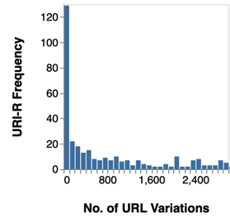
Distribution of No. URL Path Variations for each URI-R (Based on CDX Prefix Search Results)
‹#›

Slide 33
Top 25 Most Archived Sites
(Based on CDX Prefix Search Results)
# | url | depth_0 | depth_1 | depth_2 | depth_3 | depth_4+ | total
1 | newsfirst.lk | 105595 | 32240 | 7997 | 39377 | 859228 | 1044437
2 | dailymirror.lk | 23407 | 6693 | 658169 | 57804 | 268605 | 1014678
3 | ikman.lk | 2398 | 90338 | 123453 | 757483 | 34041 | 1007713
4 | adaderana.lk | 15589 | 328965 | 104850 | 372008 | 176473 | 997885
5 | virakesari.lk | 22061 | 36793 | 837170 | 33094 | 59643 | 988761
6 | ft.lk | 41696 | 5692 | 16143 | 497096 | 426792 | 987419
7 | google.lk | 37472 | 88780 | 28320 | 54788 | 770879 | 980239
8 | tamilnet.com | 23156 | 951935 | 588 | 50 | 823 | 976552
9 | news.lk | 19434 | 424301 | 46046 | 34437 | 446248 | 970466
10 | divaina.com | 25492 | 142 | 77 | 27389 | 907235 | 960335
11 | sarigama.lk | 494 | 4048 | 3234 | 38633 | 913467 | 959876
12 | rainbowpages.lk | 1474 | 10486 | 37779 | 68657 | 840963 | 959359
# | url | depth_0 | depth_1 | depth_2 | depth_3 | depth_4+ | total
13 | col3negoriginal.lk | 1864 | 55757 | 714176 | 67633 | 102632 | 942062
14 | dinamina.lk | 38695 | 61177 | 81671 | 49215 | 559209 | 789967
15 | sundaytimes.lk | 33612 | 8413 | 709911 | 348 | 0 | 752284
16 | zoom.lk | 1803 | 14044 | 381240 | 87702 | 229875 | 714664
17 | lankatruth.com | 22388 | 46944 | 339264 | 57273 | 212853 | 678722
18 | nethnews.lk | 6135 | 7292 | 477909 | 9314 | 116880 | 617530
19 | tamilmirror.lk | 17218 | 37961 | 108782 | 286397 | 62624 | 512982
20 | gossiplankanews.com | 4173 | 75878 | 42824 | 353380 | 16685 | 492940
21 | hirunews.lk | 4030 | 33864 | 301891 | 82156 | 49052 | 470993
22 | island.lk | 27861 | 2341 | 398 | 1766 | 416683 | 449049
23 | nation.lk | 16663 | 19140 | 46845 | 8629 | 319900 | 411177
24 | cbsl.gov.lk | 1938 | 10203 | 15866 | 53371 | 259589 | 340967
25 | srilankabusiness.com | 708 | 33490 | 160273 | 68278 | 75275 | 338024

Slide 34
Prefix Search Unveiled Mementos for More Internal Links
# | Exact Match | Prefix match
1 | google.lk | newsfirst.lk
2 | island.lk | dailymirror.lk
3 | dailymirror.lk | ikman.lk
4 | tamilnet.com | adaderana.lk
5 | lankadeepa.lk | virakesari.lk
6 | newsfirst.lk | ft.lk
7 | lankatruth.com | google.lk
8 | news.lk | tamilnet.com
9 | ft.lk | news.lk
10 | dailynews.lk | divaina.com

Slide 35
Summary of URL Path Variations
(Based on CDX Prefix Search Results)
Path Depth | Example | Number of URI-Rs (Post Prefix matching) | No. of URL Variations |  | No. of Mementos
 |  |  | Total | Average | Total | Average
0 | example.com | 513 | 197,705 | 384 | 935,080 | 1,816
1 | example.com/a | 510 | 1,278,065 | 2,482 | 5,178,727 | 10,056
2 | example.com/a/b | 414 | 2,706,966 | 5,256 | 9,212,387 | 17,888
3 | example.com/a/b/c | 413 | 2,177,490 | 4,228 | 6,421,469 | 12,469
4+ | example.com/a/b/c/d | 477 | 5,161,314 | 10,022 | 13,129,212 | 25,494

Slide 36
Path Depth of 2 Has the Most URL Variations
Path Depth | Example | Number of URI-Rs (Post Prefix matching) | No. of URL Variations |  | No. of Mementos
 |  |  | Total | Average | Total | Average
0 | example.com | 513 | 197,705 | 384 | 935,080 | 1,816
1 | example.com/a | 510 | 1,278,065 | 2,482 | 5,178,727 | 10,056
2 | example.com/a/b | 414 | 2,706,966 | 5,256 | 9,212,387 | 17,888
3 | example.com/a/b/c | 413 | 2,177,490 | 4,228 | 6,421,469 | 12,469
4+ | example.com/a/b/c/d | 477 | 5,161,314 | 10,022 | 13,129,212 | 25,494

Slide 37
MemGator
Memento Aggregator
Queries 16 different web archives to look for mementos for a given URI-R
Ran memgator on the 535 sites
451 URI-Rs have at least one memento in any of the archive
Sample output
url,archive,copies
3cs.lk,web.archive.org,486
3cs.lk,archive.md,1
3cs.lk,wayback.archive-it.org,92
3cs.lk,arquivo.pt,4
abansit.lk,web.archive.org,92
abansit.lk,arquivo.pt,2
ada.lk,web.archive.org,1557
ada.lk,archive.md,1
https://github.com/oduwsdl/MemGator

Slide 38
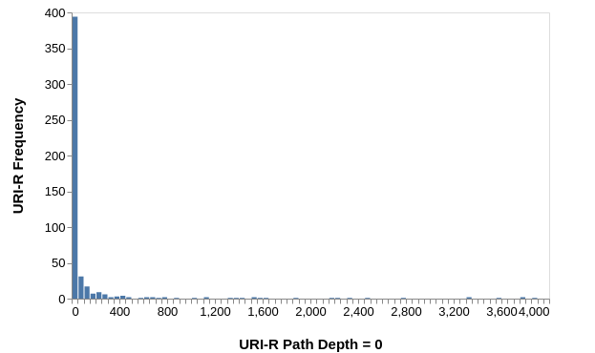
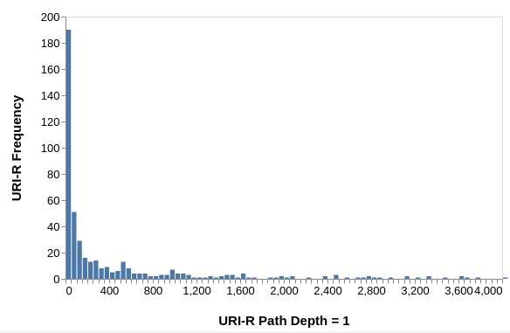
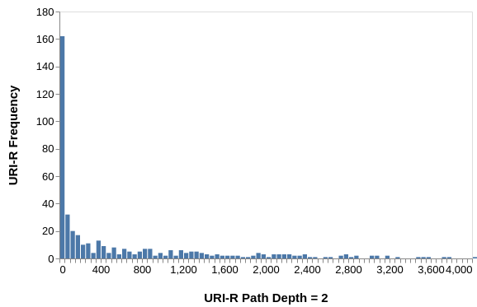
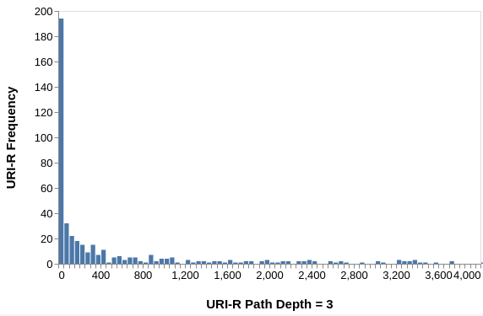
Distribution of No. URL Path Variations for each URI-R
(categorized according to path depth)
Most URI-Rs have around 50 URL variations at each path depth!
Note: Y axis range is different in each chart

Slide 39
Key Takeaways
This study evaluates how well are 535 Sri Lankan websites archived
(some of the steps in this study is inspired by Dr. Alkwai’s study on archiving Arabic websites)
Challenges:
Selecting seed URIs
Language detecting services for “Sinhala”
84% (450 out of 535) URIs have at least one memento in the Internet Archive.
News websites dominate rankings
The number of mementos in Internet Archive for a particular URI-R is positively correlated with the age of a website.
MemGator was used to check mementos for the URI-Rs across different web archives.
If any other archive has it, internet archive most definitely does!
Among Sri Lankan websites, a few websites consistently rank in the top 5 most archived sites across web archives.
CDX prefix search enabled the discovery of additional mementos for internal links.
E.g. Specific news articles

Slide 40
Backup Slides

Slide 41
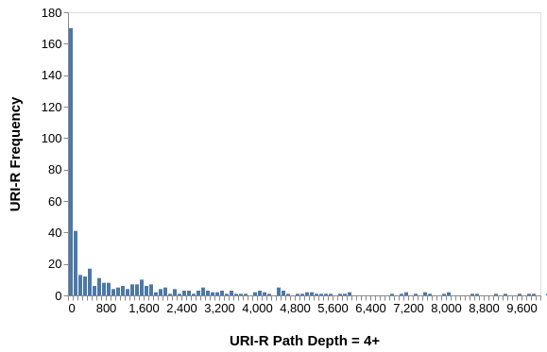
Distribution of No. URL Path Variations for each URI-R - Path Depth 4 and Higher
Notes:
bin({"step":100}
.scale({domain: [0, 10000]})

